Slide 1
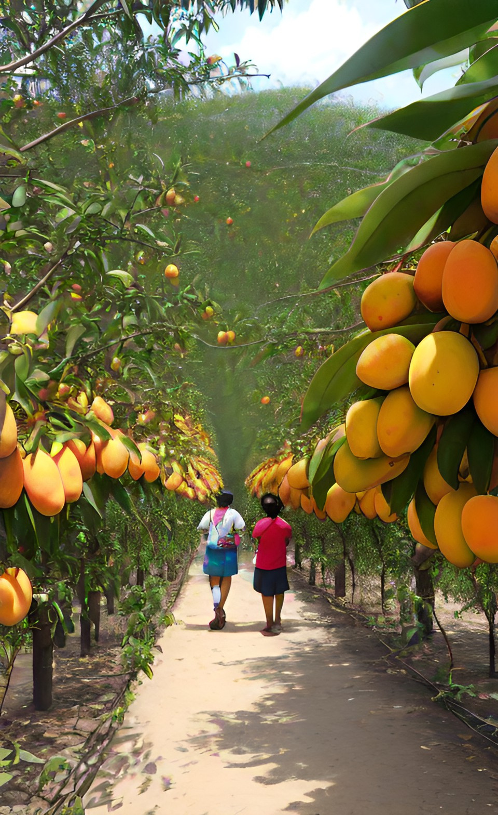
Towards Sustainable Mangoes
Traceability & Transparency

Slide 2

Outdated tracking, siloed info hinder mango chain. Blockchain needed for transparency, trust, and growth.

Slide 3



Blockchain Technology
THE FUTURE OF TRANSPARENCY
Blockchain technology is a decentralized system of data verified by a network of nodes.

Slide 4




What factors require transparency and traceability?
03/
Transport
01/
Supply Chain
04/
Waste management
02/
Anti corruption Practice

Slide 5
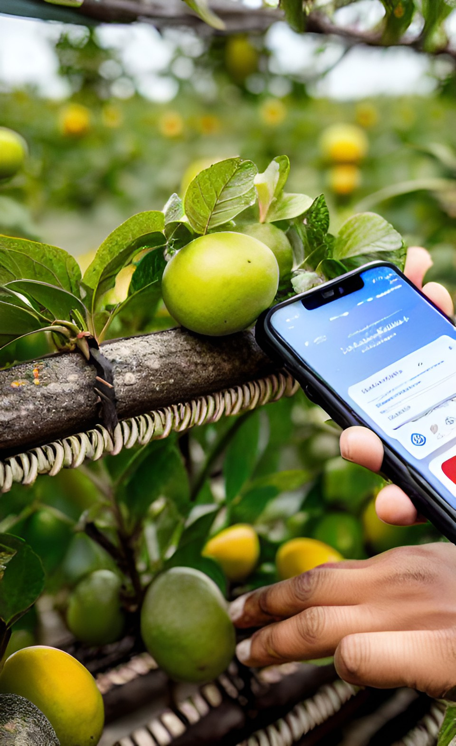
Supply Chain
The mango supply chain encompasses cultivation, harvesting, sorting, packaging, transportation, and retailing, involving stakeholders like farmers, wholesalers, distributors, retailers, and consumers, collaborating to efficiently deliver fresh mangoes from farm to market.

Slide 6
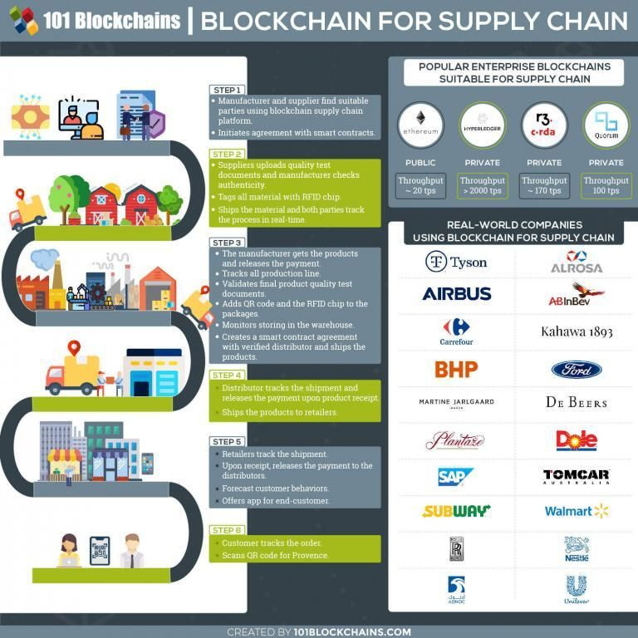
An example of a Blockchain mango supply chain

Slide 7
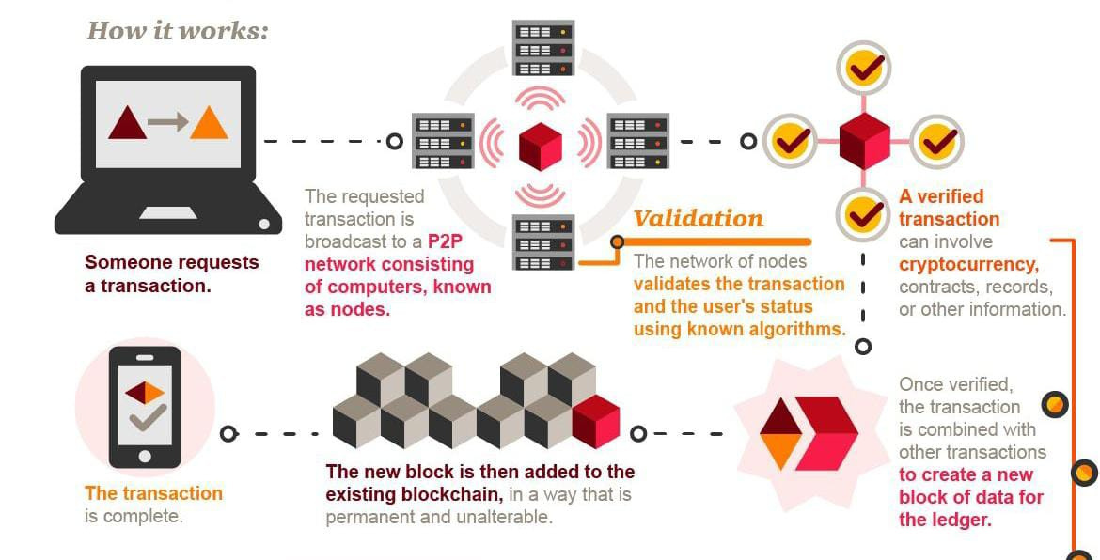
Anti-corruption practices

Slide 8
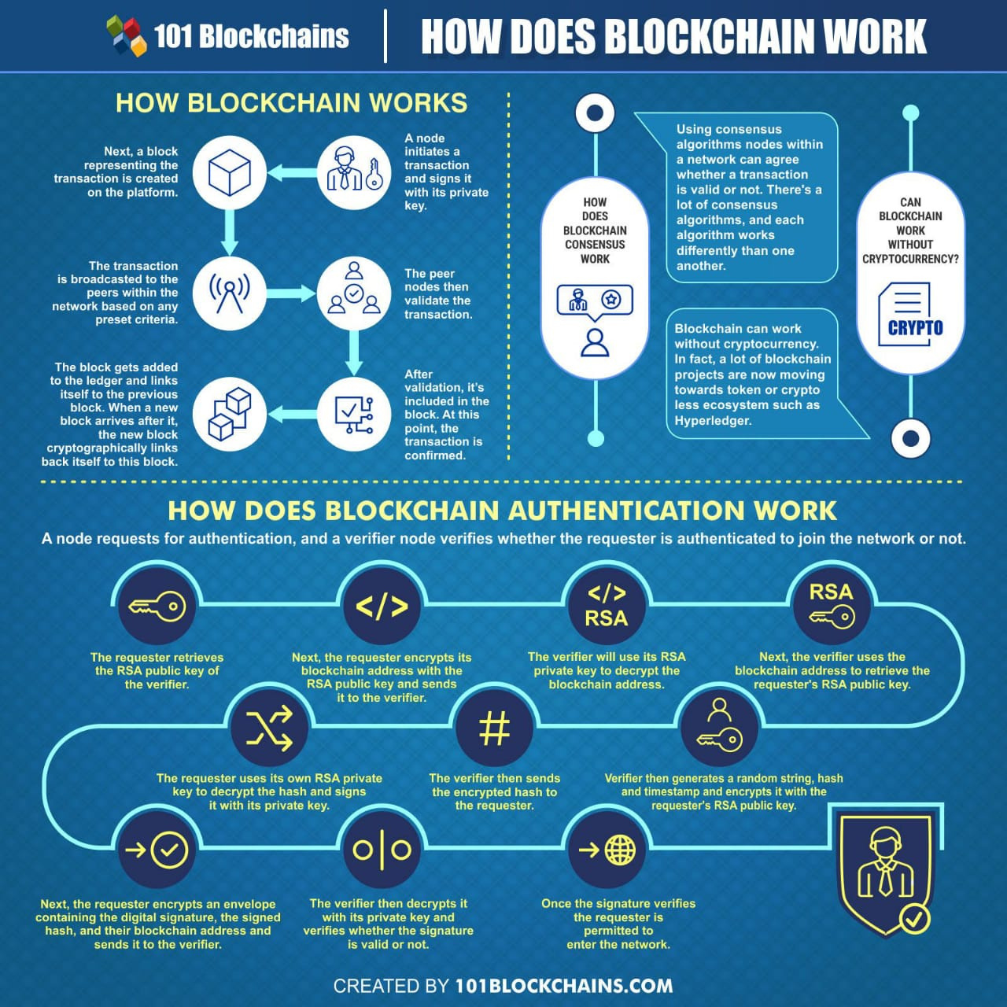
Blockchain prevents any unauthorized person from tampering with data

Slide 9



WASTE & WATER
MANAGEMENT
DIVERSE PRODUCTS
A diverse array of products from the mango pulp, seeds and peels
METHANE CAPTURE
harnessing biogas from decomposing mango waste through anaerobic digestionand also mitigat greenhouse gas emmissionse
PROPER IRRIGATION
Involves delivering the right amount of water at the right time, ensuring healthy root development and optimal fruit growth while preventing waterlogging and wastage
CUTTING EDGE TECHNOLOGY
Blockchain Technology
IoT sensors

Slide 10

ADVANTAGES AND CONSIDERATIONS OF THE BLOCKCHAIN MODEL
Blockchain boosts mango chain: Trust via transparency, traceability cuts fraud, automation trims errors, waste lessened. Privacy/security balance crucial. Challenges: IoT stability, stakeholder unity. Costs vs. benefits vital. Education, adaptation key. Scalability prep for tech evolution.

Slide 11




Who are the stakeholders ?
Mango Industry
Mango consumer
Mango Farmer
Government

Slide 12

Why is Blockchain the best solution?
  Eliminates intermediaries
  Permanently records infomation
  Enables Trust
  Data Security & privacy
  Public & Private Transparency

