Slide 1


iTATU.
Ideate. innovate. Implement
WELCOME
Unlocking Telephone Farming.
Nov. 2023

Slide 2

INTRODUCTION
Our project present a ground breaking concept telephone farming, a revolutionary approach toward sustainable and efficient food production, leveraging advanced technologies and decentralized networks.

Slide 3
OUR TEAM
Benta Johnson
Peter Limo
Florian Milimo
Student Meru university
Bsc. Commerce
A leader, policy reviewer, financial advisor,
Innovator demola global
Enthusiast about changing agriculture to be like stock investment
Student Masinde Muliro university
BSc global health and travel medicine
Alumni for the demola global projects, a data scientist, mathematic programmer, SPSS, R
Enthusiast for technology farming
Student, Egerton university
An eloquent speaker, innovator, a leader and STEM student.
Open-minded and team player.
Passionate about changing the world of agriculture in Kenya and internationally through the natural resources and energy in agricultural sector

Slide 4
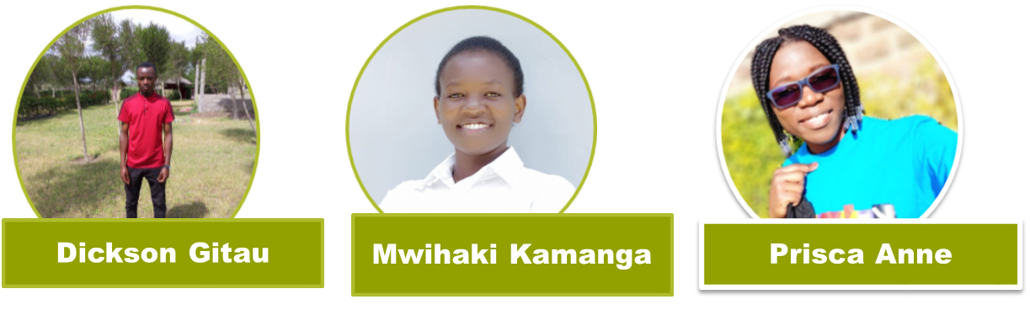
Meru university graduate
Bsc. Clinical Medicine
Passionate about agriculture and unlocking the untapped opportunities
A team player and enthusiastic innovator
Student, Egerton University
Bsc. Livestock production
An agriculturalist, Environmental analyst, project analyst and community developer
Student, Meru university
Bachelor of Business Information Technology
A passionate developer, IT advisor, business evaluator and community involvement viewer.

Slide 5

Problem
Problem
Difficulties in Balancing fulltime jobs and farming enterprises, hence lacking a new generation chose high-reward crops

Slide 6
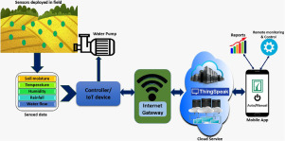
Solution
Offering training and consultation for new and technologies in agriculture and irrigation related services e.g. AI and IoT technologies through a mobile user friendly application
Consultancy

Slide 7
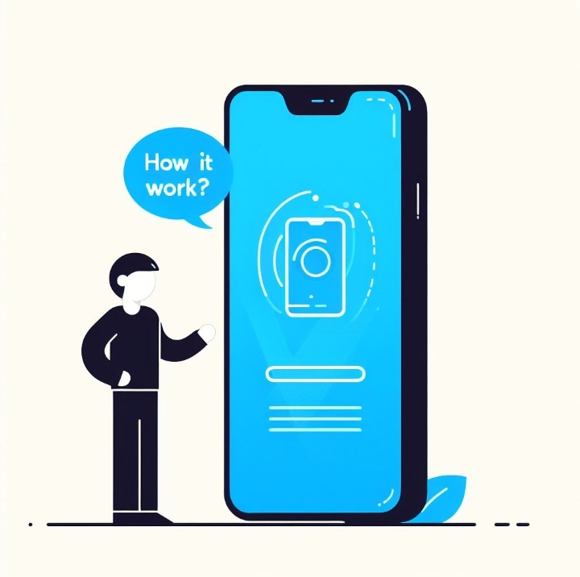
ACCOUNT SETUP & VERIFICATION
EDUCATION & CONSULTATION
RISK ASSESSMENT
EXPERTISES
IN SITE

Slide 8

Target Group;
A generation choosing High-risk high-reward crops.

Slide 9


Future
With an increase in budgetary support going to Kenyan farmers, U.S. companies may find opportunities to provide their solutions in the market. For example, there will likely be an increase in opportunities for U.S. companies to supply modern irrigation technology, water saving and irrigation management solutions particularly for drought-stricken areas, and consulting in water resource assessment in water harvesting and technology.
By providing new technologies that are cost-effective, U.S. companies can assist in strengthening the agriculture sector in Kenya.

Slide 10
Other projects
Other projects and opportunities in our group
Mobile APP (Telfarm): Pitched on Vijana na Agribiz 2023 competition held by Kenya climate innovation center. Targeting the farmers in Diaspora, busy working class, retirees and the young tech savvy generation. It Creating a hub that provides investment transparency, pre-investment advise and consultation, insurance services and financial training to help solve problems like trust and credibility, agricultural risks, limited agricultural expertise and complex agricultural chains.
Mobile App (fertilizer tracker): Targeting all farmers across the country. We are looking to have a collaboration with the government to help solve the issue of distribution of government agricultural fertilizers across the regions while reducing corruption and maintaining the quality of fertilizers issued to farmers this way increasing production and reducing crop losses due to poor quality fertilizer.

Slide 11


iTATU Ideate. innovate. implement
Visit our web!
Do you have any questions?
Email; m.maji001@gmail.com
Phone No; +254743662781
ourtechsolutions.com
Facebook; OurTechsolutions.com
Linked In; OurTech Solutions

